Slide 1
Cyber Data Analytics CS4035 Imbalanced Data and Privacy

Slide 2
Mattermost question
Say we have 3 consecutive fraudulent samples from the same credit card. The middle sample lands in the test set during cross validation. If we extracted features about the past frauds before the crossvalidation, the test sample will influence increase number of past frauds for the last training sample. My concern is such situation may appear if we extract the features before crossvalidation, should we anyway extract the features beforehand?
What do we think?

Slide 3
Mattermost question
Say we have 3 consecutive fraudulent samples from the same credit card. The middle sample lands in the test set during cross validation. If we extracted features about the past frauds before the crossvalidation, the test sample will influence increase number of past frauds for the last training sample. My concern is such situation may appear if we extract the features before crossvalidation, should we anyway extract the features beforehand?
What do we think?

Slide 4
Sequential Data Evaluation
When testing
Is it allowed to use this information?
?

Slide 5
Sequential Data Evaluation
When testing
Is it allowed to use this information?
What if I filter the data?
?

Slide 6
Sequential Data Evaluation
When testing
What about this information?
?

Slide 7
Sequential Data Evaluation
When testing
What about this information?
?
For this exercise:
You may use everything in the test-data, except the class label!
and the booking date feature!
(even that it will be used for fraud in the future??)

Slide 8
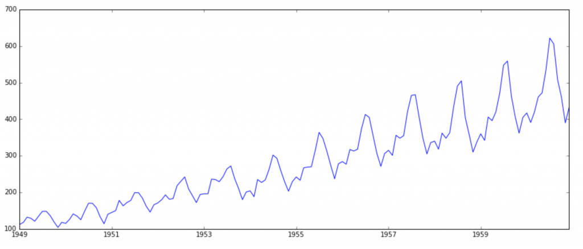
Time Series Evaluation
Suppose we use cross validation:

Slide 9
Time Series Evaluation
Suppose we use cross validation:
Q: How to predict the missing values?

Slide 10
Time Series Evaluation
Cross-validation fails for time series
Typically, next step prediction is used:
Set t = 0
t = t + 1
Learn with data until time t-1
Predict time t
Goto 2
Requires learning a very large number of models, impractical for this exercise, so simply use cross-validation…

Slide 11
Modifying machine learning
Data
Algorithm
Output
3 points where machine learning
can be modified

Slide 12
Manipulating input data
Should be well-known already
PCA before linear classification
Noise reduction (eg Fast Fourier transform)
Feature selection
…
Today:
Different sampling strategies
Synthesizing new data rows
Focus on dealing with imbalanced data
Data

Slide 13
Modifying unbalanced input data
Sampling
oversample minority class
undersample majority class
Weighting
assign large weights to minority class
assign small weights to majority class
Synthesizing
add artificial minority class instances
Important:
TEST ON UNMODIFIED TEST SET

Slide 14
The effect of sampling
-
+
+
y
-
-
+
-
+
+
+
-
+
-
+
+
+
+
x
Error = 3
What happens if we sample every - instance 10 times?

Slide 15
The effect of sampling
-
+
+
y
-
-
+
-
+
+
+
-
+
-
+
+
+
+
x
Error = 21
What is a better separator?

Slide 16
The effect of resampling
+
y
-
-
+
-
-
+
+
+
+
-
+
-
+
+
+
+
x
Error = 4

Slide 17
Study on fraud data
Data = sample < 50k rows from the fraud data (for speed)
Q: How much sampling of fraud cases is needed before a
Decision Tree
Naïve Bayes
3-NN
your favorite classifier
classifies all fraud instances correctly on training data?
What is the effect on the test data?
Remember to split train-test before sampling fraud cases!
Remember not to use the booking date feature! (cheating)

Slide 18
Study on fraud data
Sample 50k rows from the fraud data (for speed)
Q: How much undersampling of non-fraud cases is needed before a
Decision Tree
Naïve Bayes
3-NN
your favorite classifier
classifies all fraud instances correctly on training data?
What is the effect on the test data?
Remember split train-test before sampling non-fraud cases!
Remember not to use the booking date feature! (cheating)

Slide 19
Sampling issues
Oversampling issues:
overfitting: the sampled examples provide false evidence of a positive label at a very specific point, possibly an anomaly
ignorance: some classifiers ignore multiple copies (can actually be a good thing)
Undersampling issues:
information loss: some examples can be essential for good performance!
By sampling, you force the algorithm to learn from a distribution different from the testing distribution!
not really what the algorithms are built to do best…but you have to do something...

Slide 20
Less random sampling
kNN based sampling:
Sample majority instances that:
are on average close to minority instances
are closest to the furthest away monitory instances
are close for each monitory instance
…
Tomek link undersampling:
Remove instance-pairs with other class as nearest neighbor
Cluster sampling:
First cluster, then sample equally from the different clusters
...

Slide 21
Reweighting
Similar to sampling, but:
Does not remove information
Not all classifiers use weights
Many treat it similar to adding multiple minority instances
Another option is to adjust the prior distribution…
Overfitting remains a problem…

Slide 22
Adding synthetic minority instances
Key technique: SMOTE
Synthetic Minority Oversampling Technique
For every minority instance i
Randomly select one of the the k nearest neighbors x
Compute the vector v(i,x) between i and x:
i + v(i,x) = x
Randomly select a point p along this vector
p = i + rand(0,1) * v(i,x)
Add p to the minority instances

Slide 23
Adding synthetic minority instances
Key technique: SMOTE
Synthetic Minority Oversampling Technique
For every minority instance i
Randomly select one of the the k nearest neighbors x
Compute the vector v(i,x) between i and x:
i + v(i,x) = x
Randomly select a point p along this vector
p = i + rand(0,1) * v(i,x)
Add p to the minority instances

Slide 24
The effect of SMOTE
+
-
-
y
+
+
-
+
-
+
+
+
-
-
+
-
+
-
-
-
-
x

Slide 25
The effect of SMOTE
+
-
-
y
+
+
-
+
-
+
+
+
-
+
-
+
-
+
-
-
-
-
x

Slide 26
The effect of SMOTE
+
-
-
y
+
+
-
+
-
+
+
+
-
+
-
+
-
+
+
-
-
-
-
x

Slide 27
The effect of SMOTE
+
-
-
y
+
+
-
+
+
-
+
+
+
-
+
-
+
-
+
+
-
-
-
-
x

Slide 28
The effect of SMOTE
+
-
-
y
+
+
-
+
+
-
+
+
+
-
+
-
+
-
+
+
-
-
-
-
x
Error = 6

Slide 29
The effect of SMOTE
+
-
-
y
+
+
-
+
+
-
+
+
+
-
+
-
+
-
+
+
-
-
-
x
Error = 6
Is there a better separator?

Slide 30
The effect of SMOTE
-
y
+
-
+
+
-
+
-
+
+
+
+
-
+
-
+
-
+
+
-
-
-
x
Error = 5
Is there a better separator?

Slide 31
The effect of SMOTE
-
y
+
-
+
+
-
+
-
+
+
+
+
-
+
-
+
-
+
+
-
-
-
x
Error = 5
5 false positives
(benign - labeled as malicious +)
Is there a better separator?

Slide 32
The effect of SMOTE
+
-
-
y
+
+
-
+
+
-
+
+
+
-
+
-
+
-
+
+
-
-
-
x
Error = 5
1 false positive

Slide 33
The effect of SMOTE
+
-
-
y
+
+
-
+
+
-
+
Demonstrated success on many problems
Other techniques possible:
clustering-based (k-Means)
imputation-based (mice)
…
+
+
-
+
-
+
-
+
+
-
-
-
x
Error = 5
1 false positive

Slide 34
Study on fraud data
Try SMOTE on fraud data, does it help?
Q: How good is data generated by SMOTE? Is it realistic?

Slide 35
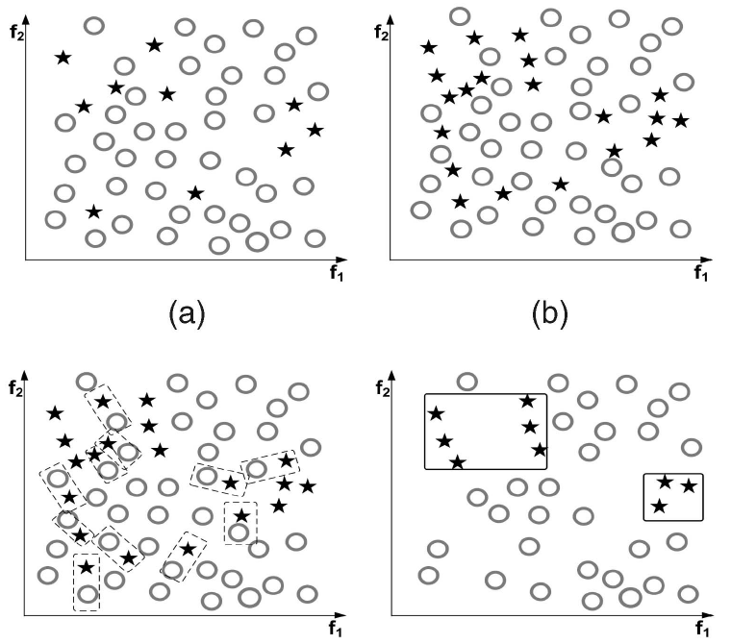
Reducing issues
Some points too close to majority points
Remove Tomek links
…

Slide 36
Realistic data generation
Idea: Randomly generate data in such a way that some statistics or relationships of the original data set are preserved
Imputation is a method to fill in missing data for analysis purposes, for instance:
using the mean estimate
copying values from nearby instances (hot deck imputation)
drawing them from a (Bayesian) model
Q: How can we use this for generating data?

Slide 37
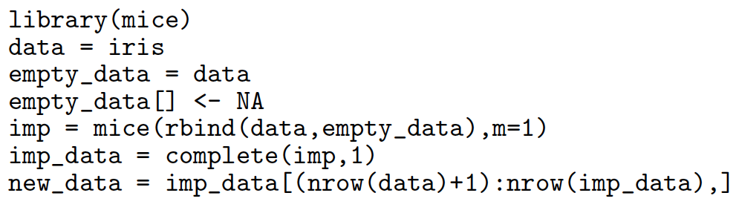
Multiple Imputation in R
Simply append empty rows to an existing table, and start imputing!

Slide 40
Synthetic data
Very hard to generate realistic data, but very useful, also to reduce privacy concerns.
Instance-based (SMOTE):
Combine existing examples into new ones, only numeric
Model-based:
Fit a distribution P(data) (Bayesian model, multinomial)
Sample from the learned distribution (model) P
Combined (MICE):
Fit a distribution P(data)
Sample from P
Replace the sampled values with values of near neighbors
aka Hot-Deck imputation

Slide 41
Modifying machine learning
Data
Algorithm
Output
3 points where machine learning
can be modified

Slide 42
Cost-sensitive threshold modification
Define a cost for false positives and false negatives
When learning rankers, such as Naïve Bayes, set the decision threshold to
optimize cost
obtain a predefined false positive rate
…
What if your favorite model is not a ranker?

Slide 43
Cost-sensitive threshold modification
Define a cost for false positives and false negatives
When learning rankers, such as Naïve Bayes, set the decision threshold to
optimize cost
obtain a predefined false positive rate
…
What if your favorite model is not a ranker?
Resample (as shown in previous slides)
Ensemble (eg random forest)
…modify code…?

Slide 44
Ensemble methods
Key idea:
Learn N models, combine their predictions
Different strategies:
How to learn different models?
How to combine them?

Slide 45
Bagging
Sample
Algorithm
Output
Learn one model by sampling with replacement and combining results by majority voting
Popular example: random forest
Data
Sample
Algorithm
Output
Vote
Sample
Algorithm
Output

Slide 46
The effect of ensembles
+
-
+
-
-
y
+
+
+
-
-
-
+
+
-
-
-
+
-
+
-
-
-
-
x
e.g., predict + if all predict +, so 2 tp, 1 fp

Slide 47
Basic random forest
Do X times:
Create data sample D
Learn tree T from D
For data row d:
Classify d using all X trees
Assign label using majority vote

Slide 48
Bagging - generalized
Sample
Algorithm
Output
Why sample uniformly at random?
Why keep the same base algorithm?
Why use majority voting?
Data
Sample
Algorithm
Output
Vote
Sample
Algorithm
Output

Slide 49
Study on fraud data
Let’s recreate a random forest classifier…
Sample, learn 10 trees.
Q: Does your own implementation work better or worse than the standard random forest classifier?
Q: Can we make it perform better on the fraud data?
Remember not to use the booking date feature! (cheating)

Slide 50
Usual random forest
Do X times:
Create data sample D
Learn tree T from D, but:
At every split, out of m features, consider a random feature subset of size √m
For data row d:
Classify d using all X trees
Assign label using majority vote

Slide 51
Extreme random forest
Do X times:
Create data sample D
Learn tree T from D, but:
At every split, out of m features, consider a random feature subset of size √m
Randomize the heuristic value v (eg. use v * rand(), or select randomly one of Gini, information gain, …)
For data row d:
Classify d using all X trees
Assign label using majority vote

Slide 52
More bag-based ensembles
Model
Output
Bayesian model averaging
Sample models instead of data!
Data
Algorithm
Model
Output
Vote
Model
Output

Slide 53
More bag-based ensembles
Algorithm 1
Output
Stacking
Learn multiple models using different algorithms!
Data
Algorithm 2
Output
Vote
Algorithm 3
Output

Slide 54
More bag-based ensembles
Algorithm 1
Output
Stacking
Learn multiple models using different algorithms!
View vote combination as another learning problem!
(input is table with predictions and target value)
Data
Algorithm 2
Output
Algorithm X
Algorithm 3
Output

Slide 55
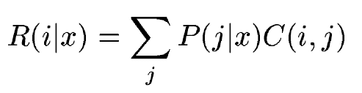
Metacost
Sample
Algorithm
Output
Minimizing conditional risk:
Use votes to relabel data, run algorithm again
Data
Sample
Algorithm
Output
Vote
Sample
Algorithm
Output
relabeled data
Algorithm

Slide 56
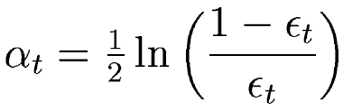
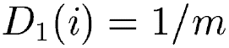
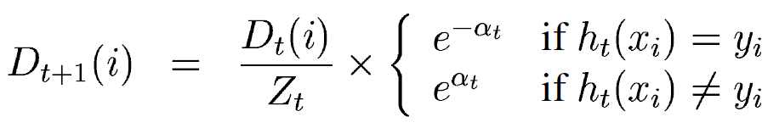
Boosting
Boost initial weight
data1
Algorithm
Output
Model importance determined by:
Initialize weights:
Assign weights:
Boost reweight
importance
vote
data2
Algorithm
Output
Boost reweight
data3
Algorithm
Output

Slide 57
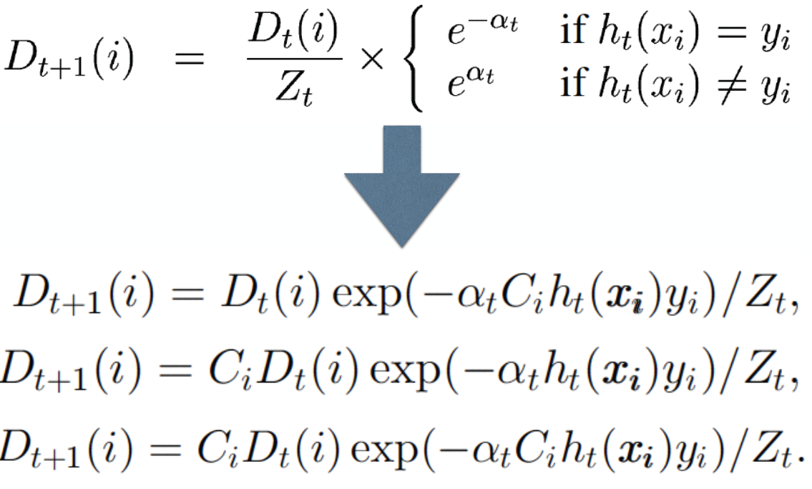
Boosting
Reweigh using misclassification cost C:

Slide 58
Boosting
Reweigh using misclassification cost C:
Where to put the cost?

Slide 59
Boosting
Reweigh using misclassification cost C:

Slide 60
Tips on bagging and boosting
Bagging mainly reduced variance
use complex (overfitting) models
Boosting mainly reduces bias
use simple “weak” (underfitting) models
Beware of the black-box nature of ensembles
Can you still explain the outcome to a client?

Slide 61
Modifying machine learning
Data
Algorithm
Output
3 points where machine learning
can be modified

Slide 62
Weighted distances
k-Nearest Neighbor class for instance i is:
sum[j=1..k](c(i,j)) / k
where c(i,j) is the class of the j-th nearest neighbor of i
Weighted by distance:
sum[j=1..k](w(i,j) * c(i,j)) / k
where w(i,j) is the weight of the j-th neighbor, eg with k neighbors:
w(i,j) = ( d(i,k) - d(i,j) ) / ( d(i,k) - d(i,1) )

Slide 63
Weighted distances
k-Nearest Neighbor class for instance i is:
sum[j=1..k](c(i,j)) / k
where c(i,j) is the class of the j-th nearest neighbor of i
Weighted by distance:
sum[j=1..k](w(i,j) * c(i,j)) / k
where w(i,j) is the weight of the j-th neighbor, e.g.:
w(i,j) = ( d(i,k) - d(i,j) ) / ( d(i,k) - d(i,1) )
Intuition:
fraud is anomalous
the closer to the anomaly
the stronger the vote of that anomaly

Slide 64
The effect of weighted distances
+
y
-
-
?
-
+
+
+
-
+
-
+
+
+
+
x
with 3 neighbors, 2 + labels, so assign a +

Slide 65
The effect of weighted distances
+
y
-
-
?
-
+
+
+
-
+
-
+
+
+
+
x
with 3 neighbors, 2 + labels, but instance
with – label has much larger weight, so assign a -

Slide 66
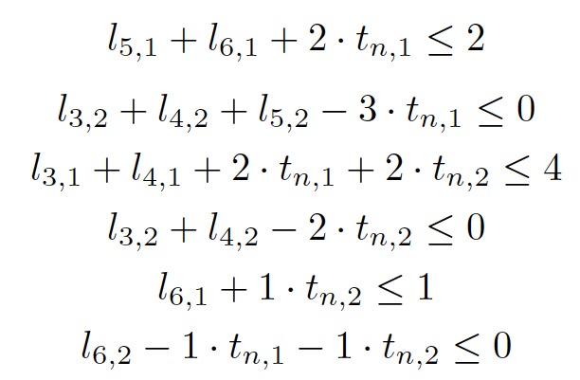

My own work - learning by optimization
 | f1 | f2 | f3 | f4 | t
1 | 5.1 | 3.5 | 1.4 | 0.2 | s
2 | 4.9 | 3.0 | 1.4 | 0.2 | s
3 | 4.7 | 3.2 | 1.3 | 0.3 | v
add
objective
translate
solve
translate

Slide 67
My own work - learning by optimization
 | f1 | f2 | f3 | f4 | t
1 | 5.1 | 3.5 | 1.4 | 0.2 | s
2 | 4.9 | 3.0 | 1.4 | 0.2 | s
3 | 4.7 | 3.2 | 1.3 | 0.3 | v
add
objective
translate
solve
translate
How to use this for imbalanced data?

Slide 68
My own work - learning by optimization
 | f1 | f2 | f3 | f4 | t
1 | 5.1 | 3.5 | 1.4 | 0.2 | s
2 | 4.9 | 3.0 | 1.4 | 0.2 | s
3 | 4.7 | 3.2 | 1.3 | 0.3 | v
add
objective
translate
solve
translate
How to use this for imbalanced data?
Find most accurate model with 0 FPs

Slide 69
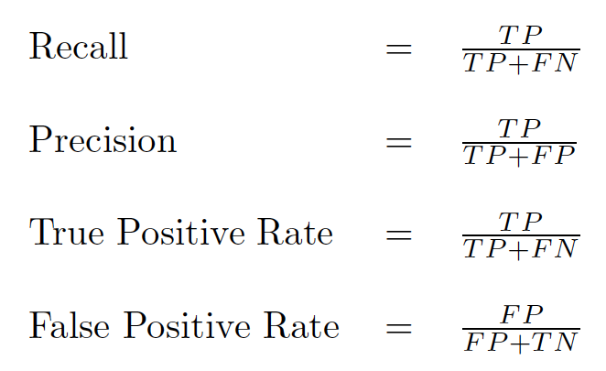
Measuring performance
Standard measures:

Slide 70
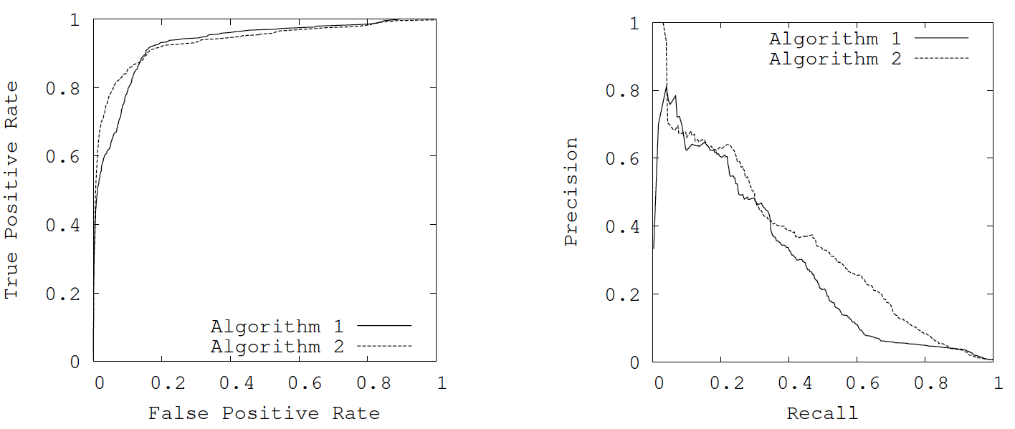
PR-curves
ROC curves are overly optimistic for imbalanced data
PR curves show difference more clealy

Slide 71

Cost curves
Plot expected cost against probability of getting a positive example
FN is the false negative rate
p(+) is simply the fraction of positive examples
C(+|-) is the cost of misclassifying a – as a +

Slide 72
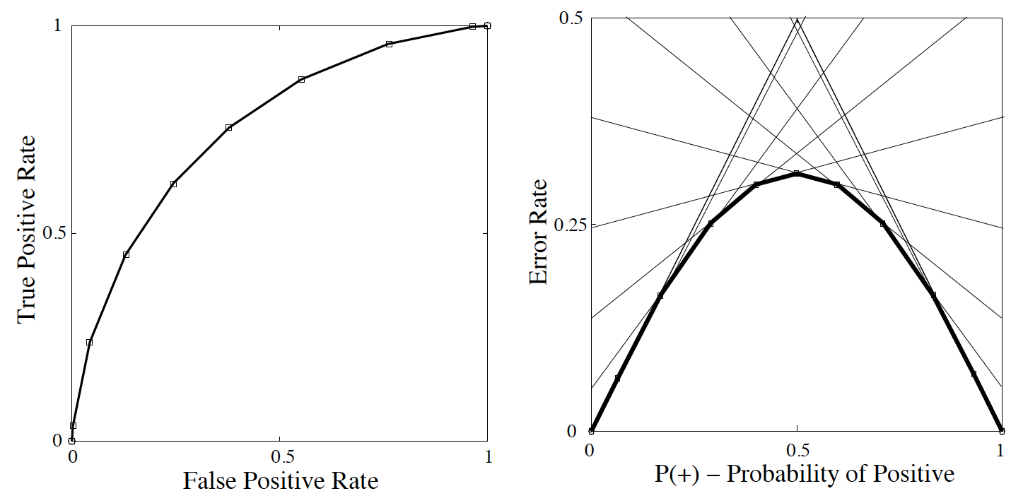
Cost curves
Every point in ROC-space is a curve in cost-space

Slide 73
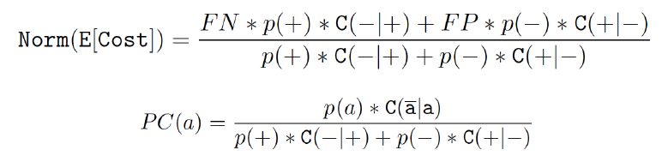
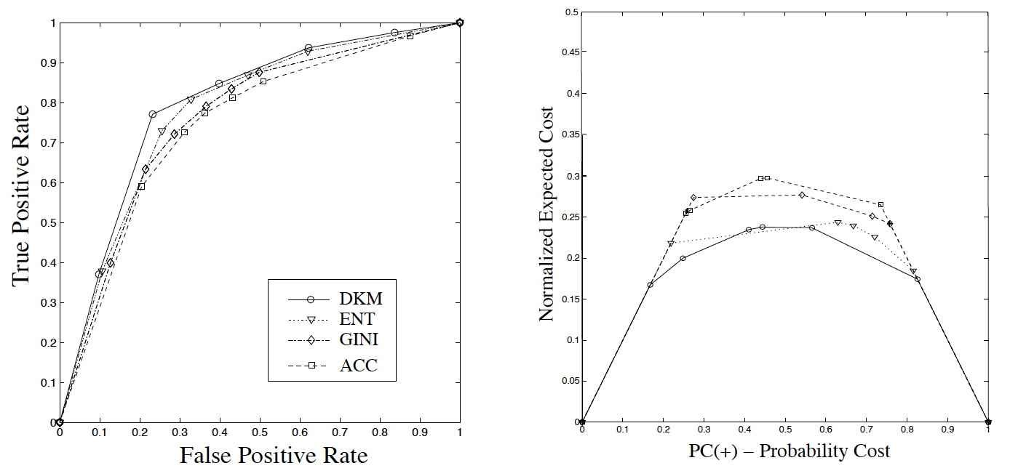
Normalized cost curves

Slide 74
Privacy in Data Analytics

Slide 75
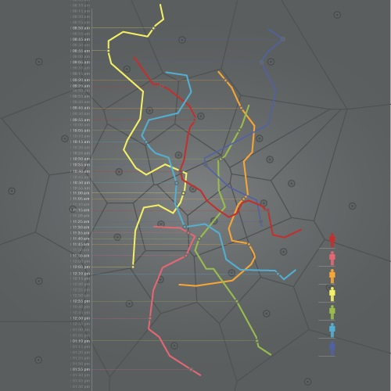
Unique in the crowd
GSM Trajectories
can be obtained
from antenna’s
These are very
identifying…

Slide 76
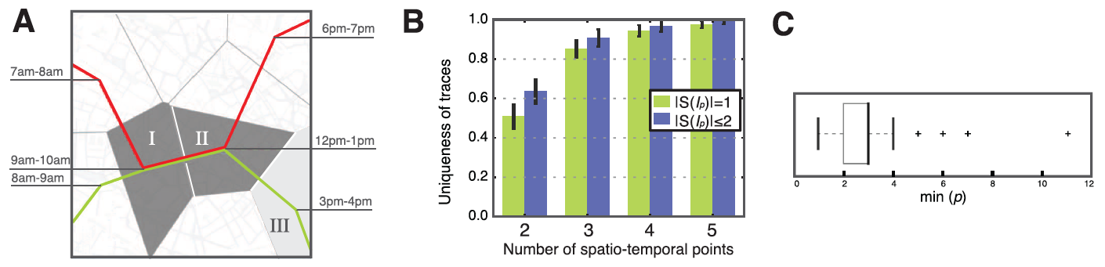

Only 4 spatio-temporal points suffice
A: two paths that are not distinguishable given cells I and II, but are given cell III
B. The percentage of unique traces given X random spatio-temporal points (for each person)

Slide 77
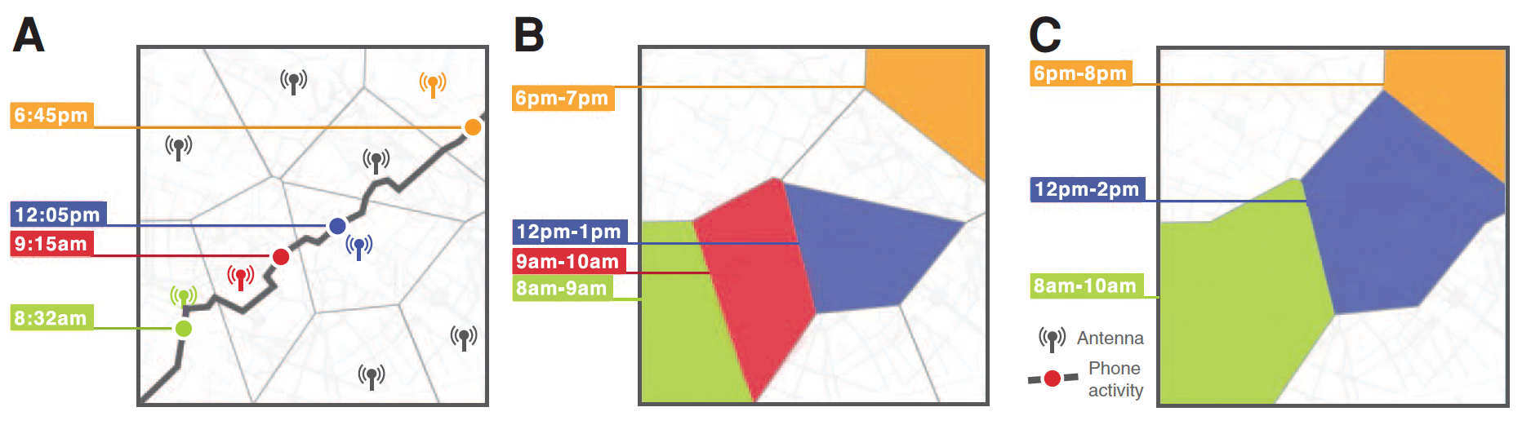
Can this be fixed?
A. original data
B. decreasing the temporal resolution
C. decreasing the spatial resolution

Slide 78
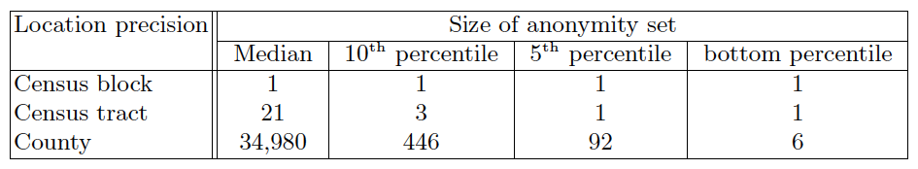
LEHD data
http://lehd.ces.census.gov/data/
Measure anonymity sets:
The size of the set of people with identical values for quantities of interest (work-home locations)
All anonimity sets sorted by size

Slide 79
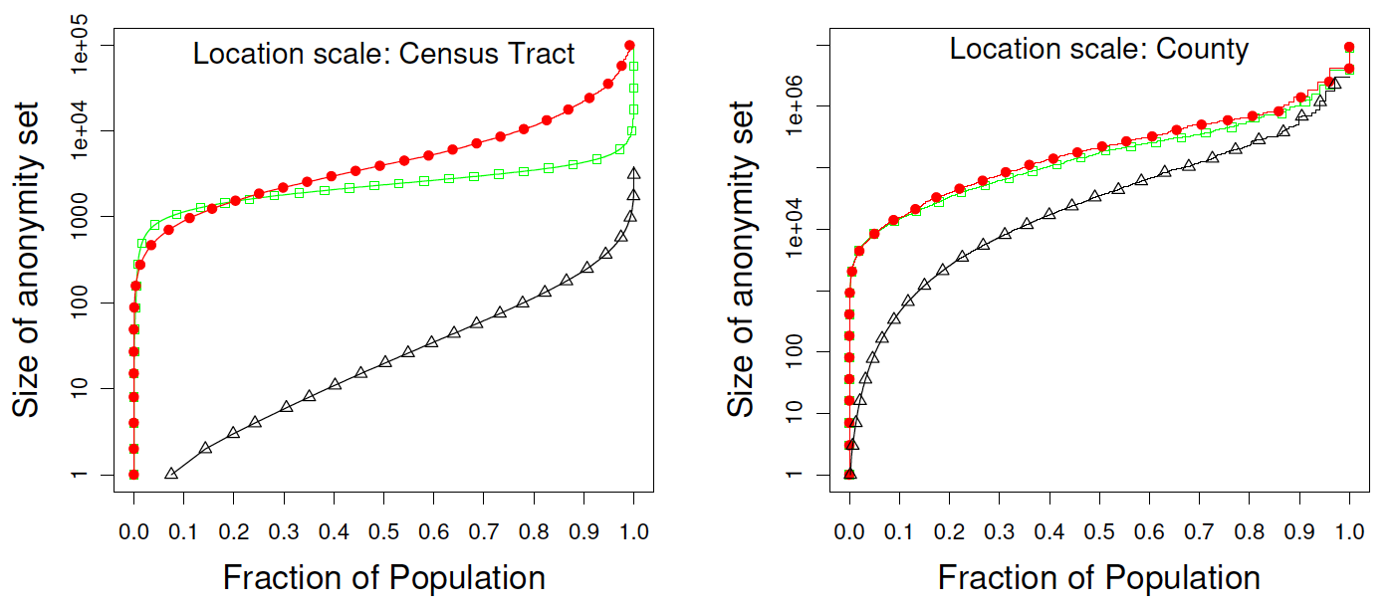
Fraction of people in A.S. of size Y
Red = revealing only work location
Green = revealing only home location
Grey = revealing both

Slide 80
Profiling & Fingerprinting
These studies focused on re-identification
If we know four visited locations and their timestamps for person X
We can with 95% certainty locate him/her in new data
If we know where person X lives and works
With 40% probability (s)he is in an anonymity set of size 10
Here a person’s profile is a small piece of data
Random sample is spatio-temporal points
Home-work locations
More specialized profiles can be learned from data, typically using probabilistic methods
A distribution over person X’s data
essentially any profiling/fingerprinting method…

Slide 81
Example: Analyzing Android Encrypted Network Traffic to Identify User Actions

Slide 82
Example: Analyzing Android Encrypted Network Traffic to Identify User Actions

Slide 83
Utility vs privacy in databases
Statistical databases must provide useful statistical information.
They must also preserve the privacy of respondents, if data are sensitive.
statistical disclosure control (SDC) methods are used to protect privacy
SDC methods modify data
SDC challenge:
protect privacy with minimum loss of accuracy
slides from Joseph Domingos-Ferrer

Slide 84
Why is this a problem?
Data
Algorithm
Output

Slide 85
Why is this a problem?
Data
Algorithm
Output
Step 1 fails

Slide 86
Disclosure concepts
Attribute disclosure
occurs when the value of a confidential attribute of an individual can be determined more accurately with access to the released statistics than without.
Identity disclosure.
It occurs when a record in the anonymised data set can be linked with a respondent's identity.
Note that attribute disclosure does not imply identity disclosure in general, and conversely.

Slide 87
Attribute Types
Identifiers
Attributes that unambiguously identify the respondent (e.g. passport no., social security no., name-surname, etc.)
Quasi-identifiers or key attributes
Identify the respondent with some ambiguity, but their combination may lead to unambiguous identification (e.g. address, gender, age, telephone no., etc.)
Confidential outcome attributes
Contain sensitive respondent information (e.g. salary, religion, diagnosis, etc.)
Non-confidential outcome attributes
Contain non-sensitive respondent info.

Slide 88
Importance of quasi-identifiers
Identifiers are of course suppressed/removed in/from anonymized data sets
Disclosure risk comes from quasi-identifiers (QIs):
QIs cannot be suppressed because they often have high analytical value
QIs can be used to link anonymized records to external non-anonymous databases (with identifiers) that contain the same or similar Qis
aka: re-identication!!!
Anonymization procedures must deal with QIs.

Slide 89
Re-identification by Linking
Microdata
Voter registration data
ID
Name
Alice
Betty
Charles
David
Emily
Fred
QID |  |  | SA
Zipcode | Age | Sex | Disease
47677 | 29 | F | Ovarian Cancer
47602 | 22 | F | Ovarian Cancer
47678 | 27 | M | Prostate Cancer
47905 | 43 | M | Flu
47909 | 52 | F | Heart Disease
47906 | 47 | M | Heart Disease
Name | Zipcode | Age | Sex
Alice | 47677 | 29 | F
Bob | 47983 | 65 | M
Carol | 47677 | 22 | F
Dan | 47532 | 23 | M
Ellen | 46789 | 43 | F

Slide 90
Re-identification by Linking
Microdata
Voter registration data
ID
Name
Alice
Betty
Charles
David
Emily
Fred
QID |  |  | SA
Zipcode | Age | Sex | Disease
47677 | 29 | F | Ovarian Cancer
47602 | 22 | F | Ovarian Cancer
47678 | 27 | M | Prostate Cancer
47905 | 43 | M | Flu
47909 | 52 | F | Heart Disease
47906 | 47 | M | Heart Disease
Name | Zipcode | Age | Sex
Alice | 47677 | 29 | F
Bob | 47983 | 65 | M
Carol | 47677 | 22 | F
Dan | 47532 | 23 | M
Ellen | 46789 | 43 | F

Slide 91
Re-identification by Linking
Microdata
Voter registration data
ID
Name
Alice
Betty
Charles
David
Emily
Fred
QID |  |  | SA
Zipcode | Age | Sex | Disease
47677 | 29 | F | Ovarian Cancer
47602 | 22 | F | Ovarian Cancer
47678 | 27 | M | Prostate Cancer
47905 | 43 | M | Flu
47909 | 52 | F | Heart Disease
47906 | 47 | M | Heart Disease
Name | Zipcode | Age | Sex
Alice | 47677 | 29 | F
Bob | 47983 | 65 | M
Carol | 47677 | 22 | F
Dan | 47532 | 23 | M
Ellen | 46789 | 43 | F

Slide 92
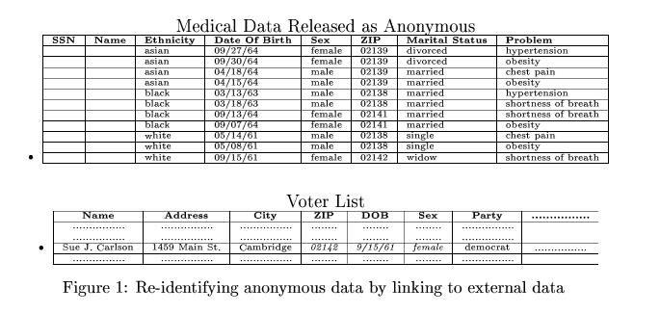
Latanya Sweeney’s Attack (1997)
Massachusetts hospital discharge dataset
Public voter dataset

Slide 93
What to do about this?
Data
Algorithm
Output

Slide 94
What to do about this?
Data’
Algorithm
Output
Let’s modify the training data!

Slide 95
Protecting Microdata
Masking. Generate a modified version X’ of the original microdata set X:
Perturbative – X’ is a perturbed version of X
Non-perturbative – X’ is obtained from X by partial suppressions or reduction of detail
the data in X’ are still true
Synthesis. Generated synthetic data X’ that preserve some preselected properties of the original data X.

Slide 96
Perturbative: adding noise
Uncorrelated noise addition:
xj’ = xj + εj where εj ~ N(0, 2),
with Cov( εi, εj ) = 0 for all i != l
Neither variances nor correlations are preserved
Correlated noise addition: As above, but
ε = (ε1 , ... , εn) ~ N( 0, aC )
with C being the covariance matrix of the original data
Means and correlations can be kept by choosing appropriate a
But this influences the relationships between features!
Q: can we fix this?

Slide 97
Perturbative: adding noise
Uncorrelated noise addition:
xj’ = xj + εj where εj ~ N(0, 2),
with Cov( εi, εj ) = 0 for all i != l
Neither variances nor correlations are preserved
Correlated noise addition: As above, but
ε = (ε1 , ... , εn) ~ N( 0, aC )
with C being the covariance matrix of the original data
Means and correlations can be kept by choosing appropriate a

Slide 98
Perturbative: PRAM
The Post-RAndomization Method (PRAM) applies noise to categorical attributes
Each value of a categorical attribute is changed to a different value according to a prescribed Markov matrix (PRAM matrix)
i.e. Pr(vi |vj) = pij, sumj(pij) = 1.0
PRAM can be viewed as encompassing noise addition, data suppression and data recoding
How to optimally determine the PRAM matrix is not obvious
Being probabilistic, PRAM can afford transparency (publishing the PRAM matrix does not allow inverting anonymization)

Slide 99
Perturbative: ε-Differential Privacy
A randomized query function F gives ε- differential privacy if, for all data sets D1, D2 such that one can be obtained from the other by modifying a single record, and all S in Range(F):
Pr(F(D1) ∈ S) <= exp(ε) * Pr( F(D2) ∈ S)
Usually F(D) = f (D) + Y (D), where f (D) is a user query to a database D and Y (D) is a random noise (typically Laplace)
Create a data-set by iteratively asking differentially private content or counting queries

Slide 100
Perturbative: ε-Differential Privacy
A randomized query function F gives ε- differential privacy if, for all data sets D1, D2 such that one can be obtained from the other by modifying a single record, and all S in Range(F):
Pr(F(D1) ∈ S) <= exp(ε) * Pr( F(D2) ∈ S)
Usually F(D) = f (D) + Y (D), where f (D) is a user query to a database D and Y (D) is a random noise (typically Laplace)
Create a data-set by iteratively asking differentially private content or counting queries
More information in Privacy Enhancing Technologies course (by dr. Z. Erkin and dr. A. Peters)...

Slide 101
Perturbative masking: rank swapping
Rank values of each attribute in ascending order
For each attribute A and row R
Randomly select another row R’ from [R-p,R+p]
Swap the values of A for R and R’
The p value ensures that swapped values are somewhat close

Slide 102
Perturbative masking: rank swapping
Rank values of each attribute in ascending order
For each attribute A and row R
Randomly select another row R’ from [R-p,R+p]
Swap the values of A for R and R’
The p value ensures that swapped values are somewhat close
Q: how does this influence data characteristics?

Slide 103
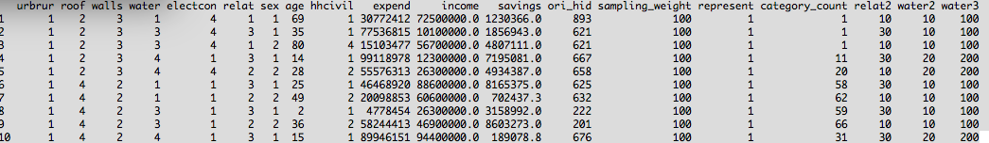
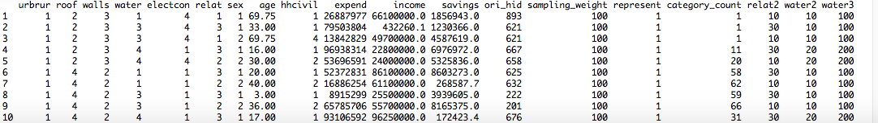
Example
before
after

Slide 104
Example
before
after
Non-identifying attributes typically remain the same, identifying attributes are modified but similar

Slide 105
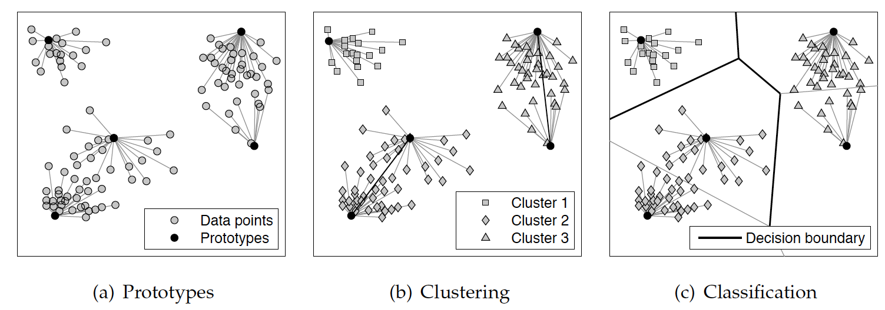
Perturbative: microaggregation
Family of SDC techniques that partition records in groups of at least k (k-partition) and publish the average/min/max record of each group.
Typically: minimize SSE
or MSE

Slide 106
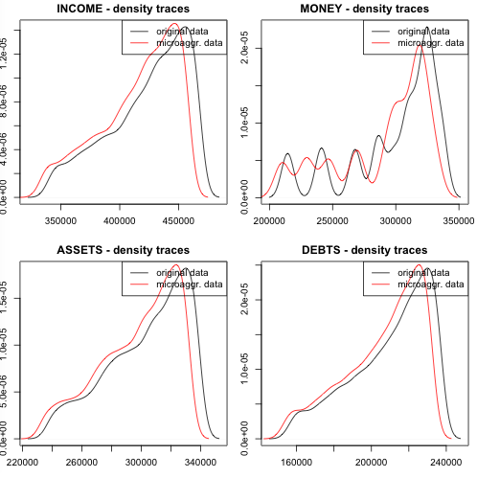
Example
Although all data
points are clustered
into groups of
size 3
Their probabilistic
density functions
remain intact!

Slide 107
Perturbative: microaggregation
Fixed group size microaggregation sets the size of all groups of records (except perhaps one) to k, while variable group size allows the size of groups to vary between k and 2k - 1
Exact optimal microaggregation can be computed in polynomial time only for a single attribute
For several attributes, microaggregation is NP-hard and algorithms are heuristics, i.e., k-Means or prototypes, etc.
Can be applied to categorical data using suitable definitions of distance and average

Slide 108
k-anonymity
A data set is said to satisfy k-anonymity if each combination of values of the quasi-identifying attributes in it is shared by at least k records
i.e. size of smallest anonymity set, but defined on quasi-identifiers
Microaggregation of the projection of records on their quasi-identiers can achieve k-anonymity

Slide 109
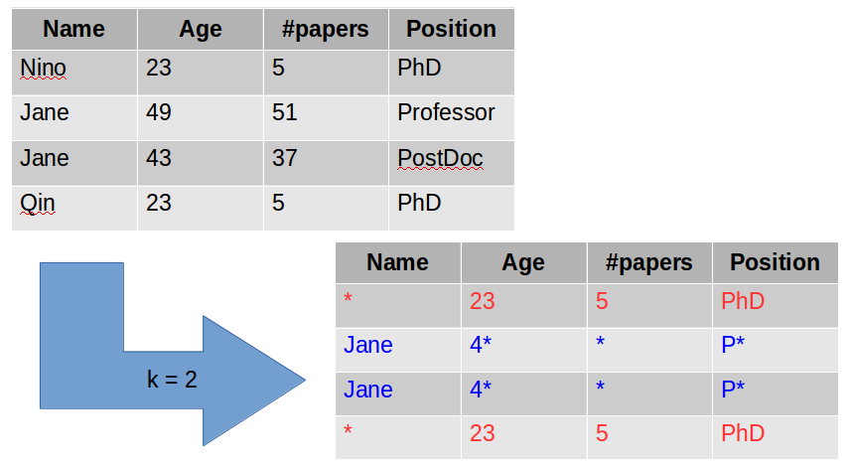
example

Slide 110
Non-perturbative: sampling
Instead of publishing the original microdata, a sample of the original set of records is published
Sampling with a low sampling fraction may suffice to anonymize categorical data (probability that a sample unique is also a population unique is low)
For continuous data it should be combined with other methods:
unaltered values of continuous attributes are likely to yield unique matches with external non-anonymous data

Slide 111
Non-perturbative: generalization
For a categorical attribute, several categories are combined to form new (less specific) categories
For a continuous attribute, it means discretizing
Example. For a record with
“Marital status = Widow” and “Age = 17”
Generalization of “Marital status” to create a broader category “Widow or divorced”
Decreases the probability of the record being unique

Slide 112
Non-perturbative: local suppression
Certain values of individual attributes are suppressed in order to increase the set of records agreeing on a combination of quasi-identifier values
Example: remove all “Widow” values from data, treat them as missing or “other”
Can be combined with generalization
Key algorithm for achieving k-anonymity performs both suppression and generalization
mu-Argus http://neon.vb.cbs.nl/casc/mu.htm
Datafly, Incognito, http://cs.utdallas.edu/dspl/cgi-bin/toolbox/
Global suppression removes entire attributes

Slide 113
Any other ideas?

Slide 114
Any other ideas?
SMOTE?
Synthesize using multiple imputation?
...
Essentially any of the methods discussed that manipulate training data can work since we mainly care about learning a good model from the data!

Slide 115
Synthetic data
Pros:
No respondent re-identication seems possible, because data are synthetic.
Cons:
If a synthetic record matches by chance a respondent's attributes, re-identification is likely and the respondent will find little comfort in the data being synthetic…
Data utility of synthetic microdata is limited to the statistics and relationships pre-selected at the outset
Analyses on random subdomains are no longer preserved.
Partially synthetic data is more flexible

Slide 116
Anonymization freeware
Argus, with -Argus for microdata and -Argus for tables.
http://neon.vb.cbs.nl/casc
sdcMicro. Statistical Disclosure Control methods for anonymization of microdata and risk estimation
http://cran.r-project.org/package=sdcMicro
ARX, k-anonymity, l -diversity, t-closeness (extensions of k-anonimity) implementation in Java
http://arx.deidentifier.org
Mice, for multiple imputation

